Slide 1
Using Big Data to Improve Product Quality
Thomas Debeauvais
tdebeauv@uci.edu
License: CC-BY

Slide 2
Outline
Netflix recommendations
What is big data?
Industry examples
A technical example: singular value decomposition for recommender systems
Thought exercises

Slide 3

“Connecting people to the movies they love”
Notes:
Mission: “continuously improving the customer experience”.
How does Netflix use big data to improve the quality of its product?

Slide 4

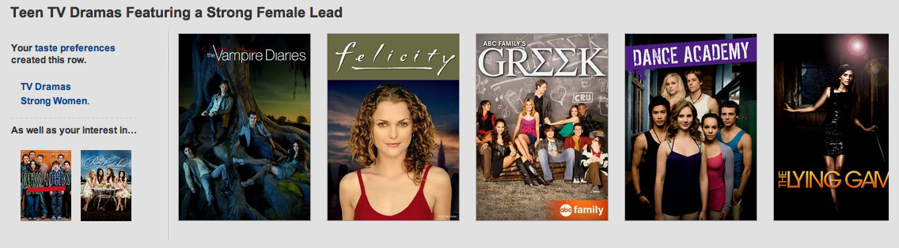
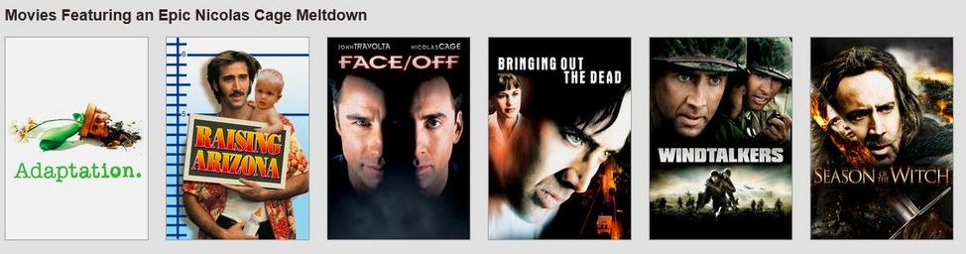
http://genresofnetflix.tumblr.com/

Slide 5
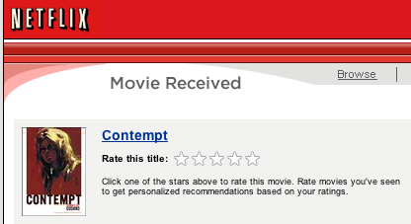
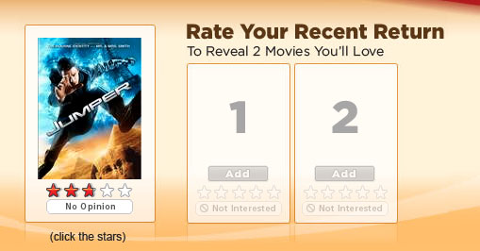

Slide 6

Intuitions
1- People rate movies high
They generally don’t bother rating bad movies
I ONLY RATE BAD MOVIES!

Slide 7
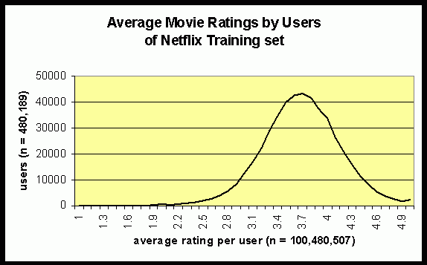
People rate movies high
http://www.netflixprize.com/community/viewtopic.php?pid=5941#p5941

Slide 8
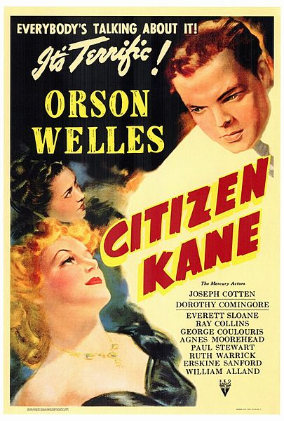
Intuitions
2- Older movies are rated higher
Nostalgia
Netflix keeps only the best of old movies

Slide 9
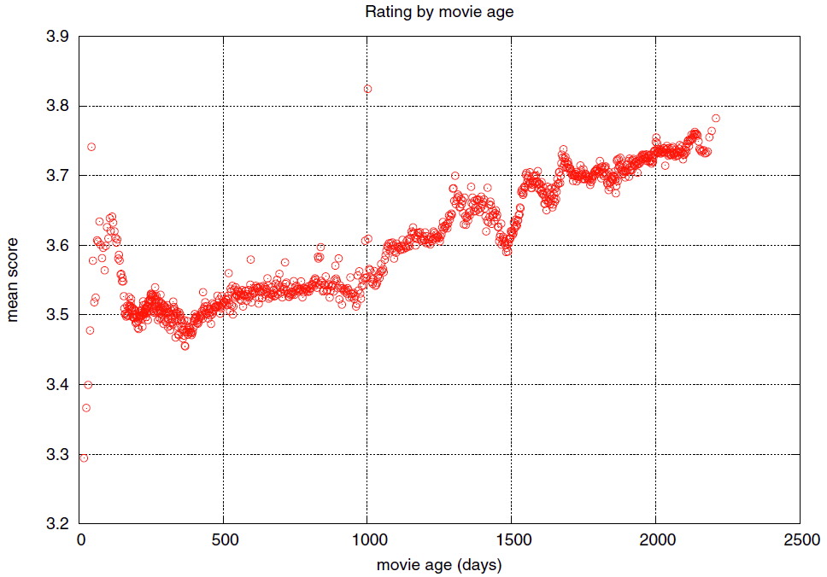
Older movies are rated higher
From Paddraic Smyth

Slide 10
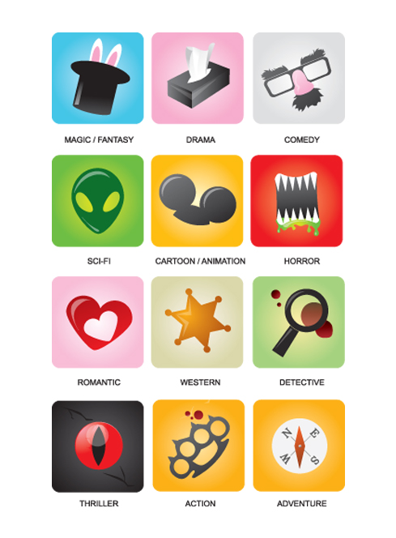
Intuitions
3- Movies have genres

Slide 11
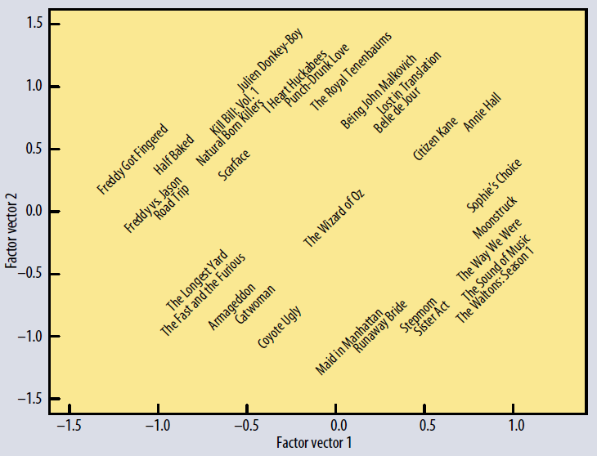
Independent
Comedy
Horror
Drama
Female lead
Mainstream
[Koren et al. 2009]

Slide 12
Take-away
Confirm or reject intuitions with data

Slide 13
What is big data?

Slide 14
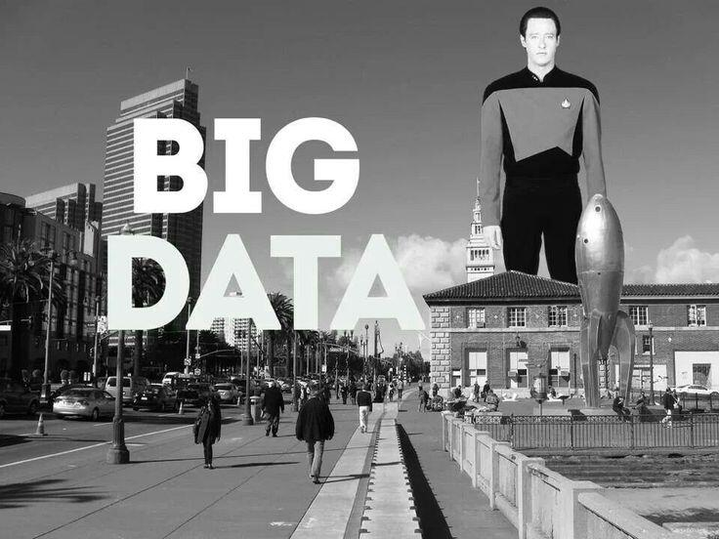

Slide 15
Data mining
Define problem
Collect data
Clean up data
Measure or model
Report
Notes:
Data mining
Also called “fishing for results” in old-fashioned stats

Slide 16
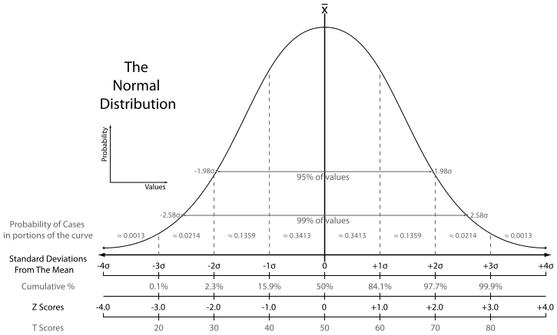
Statistics
Notes:
Old-fashioned stats

Slide 17
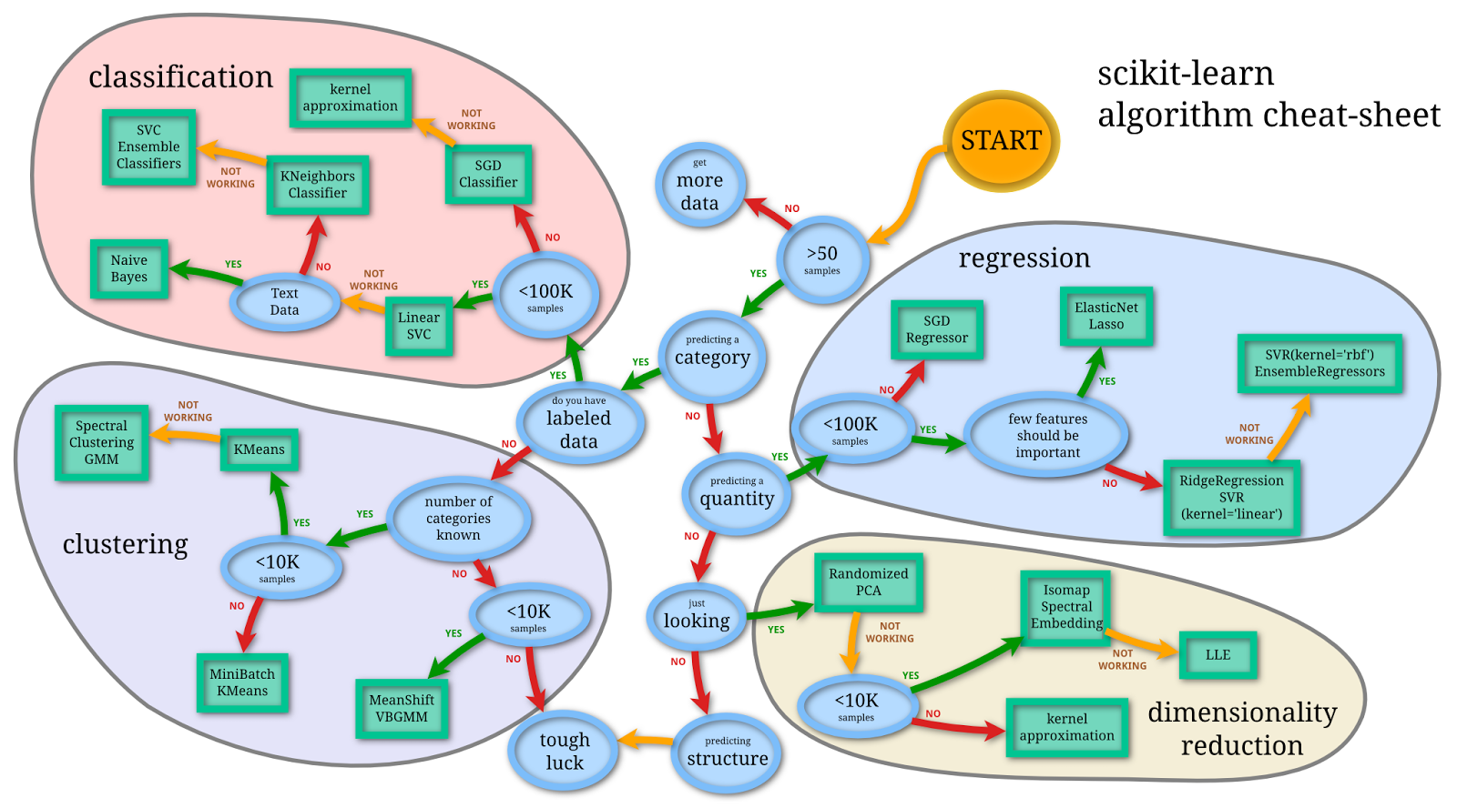
Machine learning
http://n-chandra.blogspot.com/2013/01/picking-machine-learning-algorithm.html
Notes:
Machine learning

Slide 18
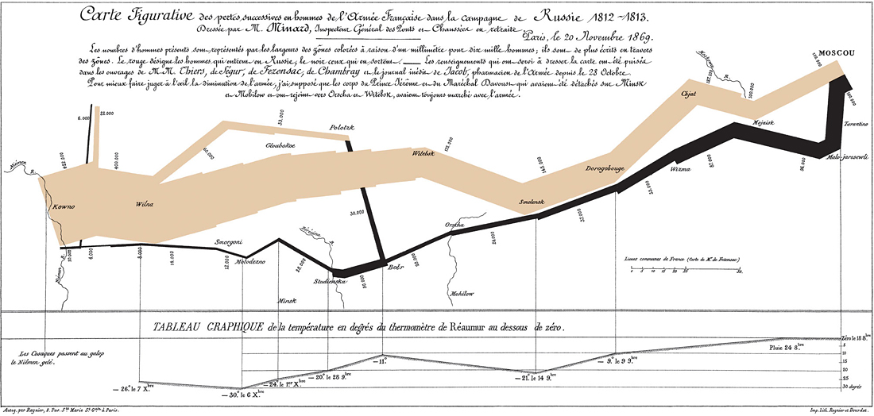
Visualization
Notes:
visualization

Slide 19
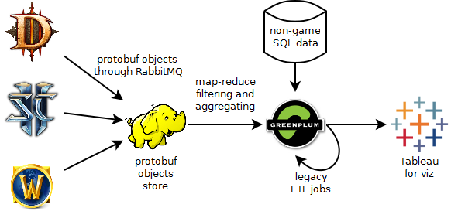
Data engineering
http://bowling-bash.blogspot.com/2013/10/blizzards-hadoop-platform.html
Notes:
Data engineering – closest to QA?

Slide 20
Take-aways
Many tools and processes
Some old, some recent
Pick the right one for the problem at hand

Slide 21
Industry examples

Slide 22



Notes:
Search engines
Google: Ads
Trulia: market value based on nearby prices
Linkedin: what skillset to expect from UI/UX designers? How long do engineers stay at Google?

Slide 23


Notes:
Association rule mining
Target: targeted marketing, coupons
FredMeyers: aisles and product placement
Turnstyle: detect affluence in small shops of Toronto based on number of phone signals

Slide 24



Notes:
Recsys
With enough data, the system can always find someone similar to you – and suggest you stuff

Slide 25
Take-aways
Useful
Everywhere
Creepy?

Slide 26
Singular value decomposition

Slide 27
[Koren et al. 2009]
Notes:
Goal: this graph, and thereby obtaining movie labels (= the axes)

Slide 28
Ratings data
 | The Longest Yard | Citizen Kane | Fast & Furious | Kill Bill | Sound of Music
Alice | 1 | 4 | 1 |  | 5
Bob | 5 |  | 4 | 4
Claire |  | 4 | 2 |  | 4
Dan | 4 | 1 |  | 3
Eve |  | 3 |  |  | 5
Frank | 3 | 3 | 5 | 2
(usually 99% sparse)

Slide 29
Singular Value Decomposition
Users Tastes Movies
 | The Longest Yard | Citizen Kane | Fast & Furious | Kill Bill | Sound of Music
Alice | 1 | 4 | 1 | M | 5
Bob | 5 | M | 4 | 4 | M
Claire | M | 4 | 2 | M | 4
Dan | 4 | 1 | M | 3 | M
Eve | M | 3 | M | M | 5
Frank | 3 | 3 | 5 | 2 | M
*0.1 | Factor 1 | Factor 2
Alice | -4 | 7
Bob | -5 | -4
Claire | -4 | 2
Dan | -4 | -5
Eve | -4 | 0
Frank | -4 | 0
 | F1 | F2
F1 | 18 | 0
F2 | 0 | 4
*0.1 | The Longest Yard | Citizen Kane | Fast & Furious | Kill Bill | Sound of Music
F1 | -4 | -4 | -4 | -4 | -5
F2 | -5 | 4 | -6 | 1 | 4
=
x
x
M = global average = 3.3
Notes:
“Matrix factorization models map both users and items to a joint latent factor space of dimensionality f, such that user-item interactions are modeled as inner products in that space.”
Qi = “the extent to which the movie possesses those factors”
Pu = “the extent of interest the user has in movies high on the corresponding factors”
“transpose(Qi) * Pu captures the user’s overall interest in the movie’s characteristics. This approximates user u’s rating of movie i”

Slide 30
[Koren et al. 2009]

Slide 31
Alice
Claire
Eve
Bob
[Koren et al. 2009]

Slide 32
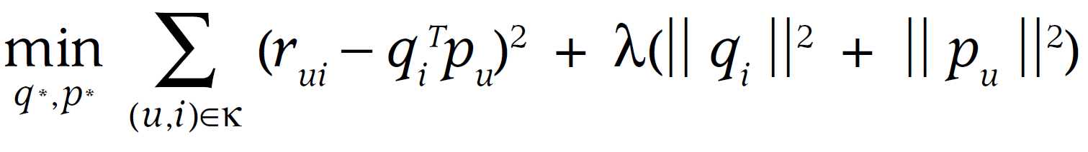
Densifying sparse matrices
Number of ratings x100
Storage x100
SVD is O(N³), CPU x1M
Minimize square error on known ratings using stochastic gradient descent
 | Armageddon | Citizen Kane | Fast & Furious | Kill Bill | Sound of Music
Alice | 1 | 4 | 1 | M | 5
Bob | 5 | M | 4 | 4 | M
Claire | M | 4 | 2 | M | 4
Dan | 4 | 1 | M | 3 | M
Eve | M | 3 | M | M | 5
Frank | 3 | 3 | 5 | 2 | M
Notes:
U = User
I = movie
R = rating
Q = movie bias
P = user bias
Lambda = regularization parameter, needs tuning
K = training set = known pairs of ratings: (user, movie)

Slide 33
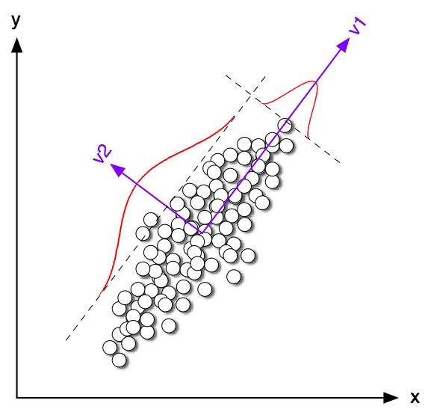
Similar techniques
Latent Semantic Analysis
Movies -> documents, ratings -> tf-idf
Latent Dirichlet Allocation
Cf “A theory of aspects as latent topics”
Principal Component Analysis
Eigen value decomposition
Of the covariance matrix

Slide 34
Take-aways
Matrices
Need practical methods
The math escalates quickly
But you may need it …

Slide 35
How would you do …

Slide 36
Amazon
“Frequently bought together”
Association rule mining
Customer clustering
SVD
(Stock management
Poisson process?)

Slide 37
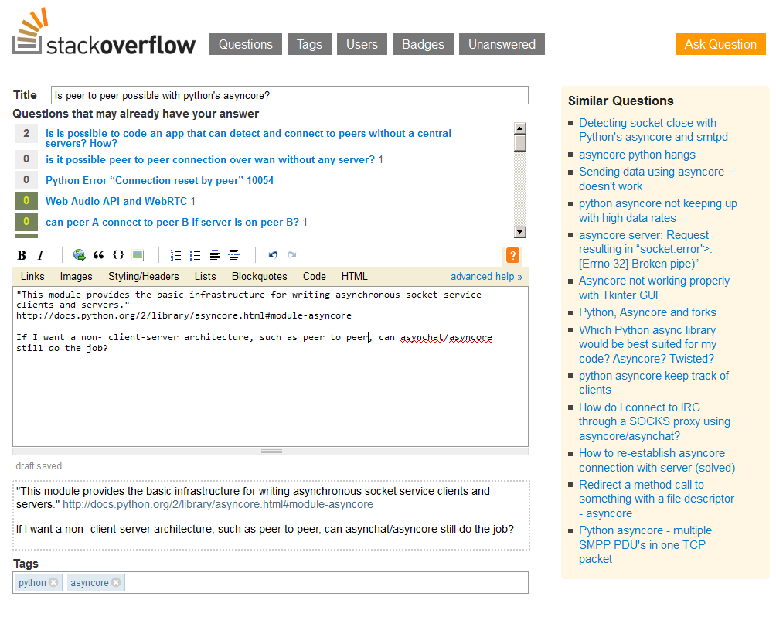

Slide 38
Dating website
Match %
SVD on weighted questions
“Would you rather be weird or normal?”= 99% weird
“Sex before marriage?”
SVD on tf-idf from profile essays
Cosine distance in SVD space
Actual information in a profile
Everybody loves travelling, but they say it differently
“I love travelling!” = “travel” = low tf-idf
“Have a passport!” = “passport” = high tf-idf
Tf-idf is not always appropriate!

Slide 39
thanks
Thomas Debeauvais, tdebeauv@uci.edu

Slide 40
References
Padhraic Smyth’s slides on Netflix recsys http://www.ics.uci.edu/~smyth/courses/cs277/public_slides/recommender_systems_part2.pdf
Koren et al. 2009: Matrix factorization techniques for recommender systems
http://www.theatlantic.com/technology/archive/2014/01/how-netflix-reverse-engineered-hollywood/282679/
http://online.wsj.com/news/articles/SB10001424052702303453004579290632128929194

